Slide 1
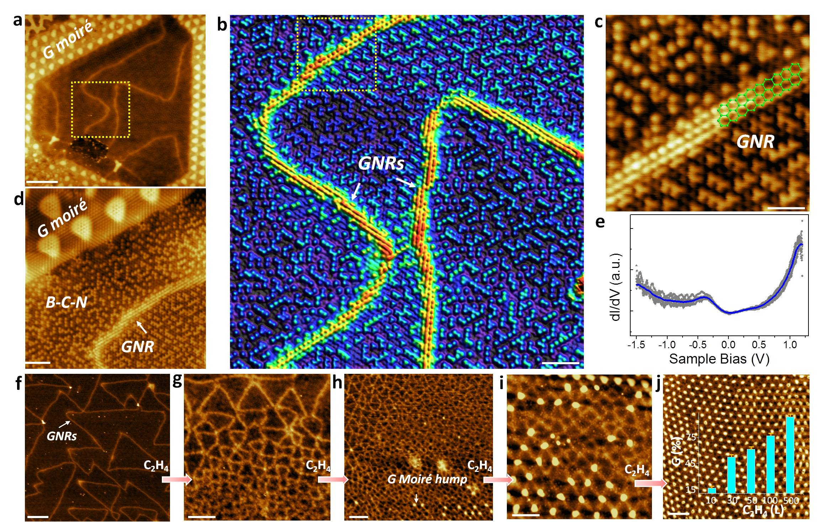
Brick-and-Mortar Structure of Graphene Nanoribbons
surrounded by BC2N.

